Slide 1
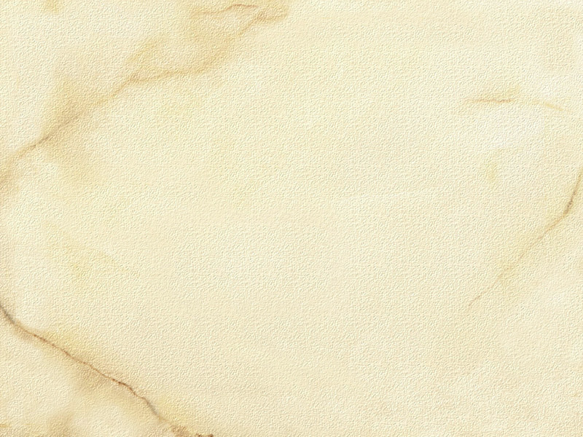
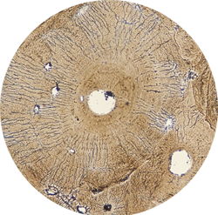
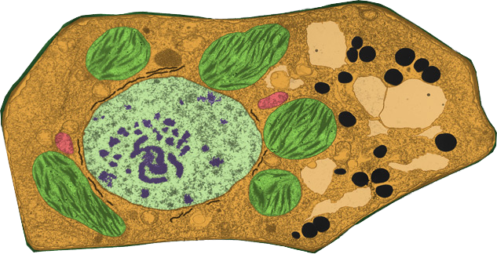

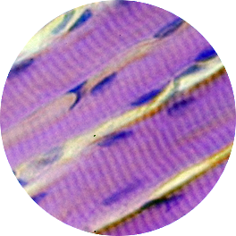
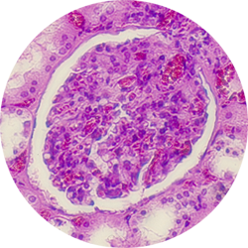

Cell Biology & Biochemistry Series:Set 2
Version: 1.0

Slide 2
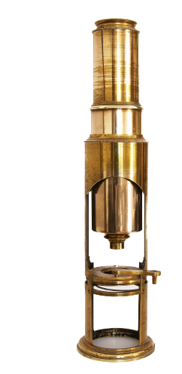
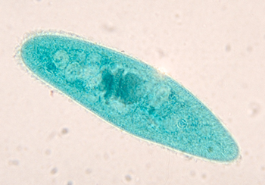
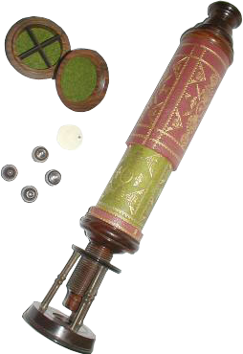
The Cell Theory
The idea that all living things are composed of cells developed over many years and is strongly linked to the invention and refinement of the microscope.
Early microscopes in the 1600s
opened up a new field of biology: the study of cell biology and microorganisms.
Some of the first organisms to be studied were the single celled planktonic organisms of pond water.
The cell theory that arose from the early studies of cells and tissues is a fundamental idea of biology.
Paramecium
Culpepper-type microscope, circa 1800
Early English microscope, circa1680

Slide 3
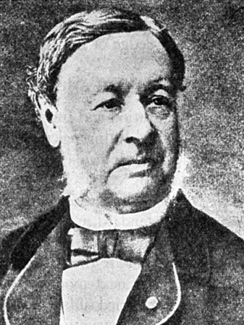
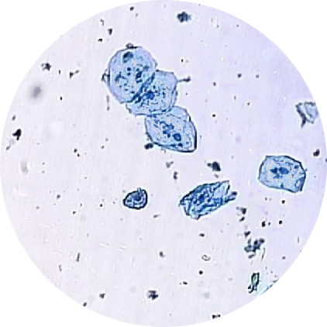
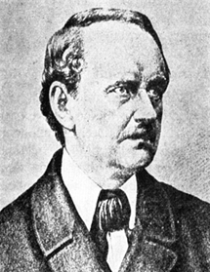
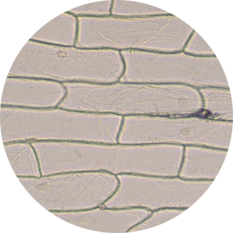
Advancements in
Cell Biology
The development of microscopy was a key factor in
advancing cellular biology.
Many significant breakthroughs occurred in the period
between the 1500s and the 1800s including
the discovery and use of the term cells.
  1595: Janssen credited with the first
  compound microscope.
  1655: Hooke described 'cells' in cork.
  1674: Leeuwenhoek discovered
  protozoa and bacteria 9 years later.
  1838: Schleiden and Schwann
  proposed cell theory based
  on their observations of plant
  and animal cells.
Theodor Schwann:
a German cytologist and physiologist
Cheek cells X100
Onion cells X50
Matthias Schleiden: a German botanist

Slide 4
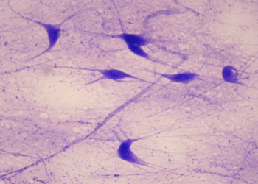
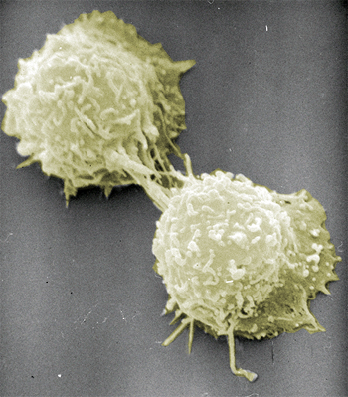
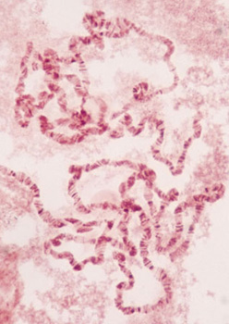
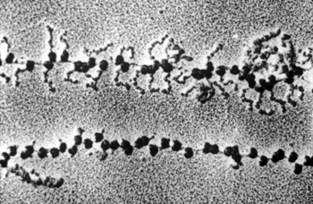
The Cell Theory
The idea that cells are fundamental units of life is part of the cell theory. The basic tenets of the cell theory are:
All living things are composed of
cells and cell products.
New cells are formed only by the
division of preexisting cells.
A cell contains the inherited
information (genes) used as the
instructions for growth, functioning,
and development.
The cell is the functioning unit
of life; all of the chemical
reactions of life take place
within cells.
Cells make up living things
➙
New cells form by division
Cells contain a blueprint
Metabolic reactions occur in cells

Slide 5
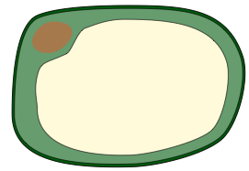

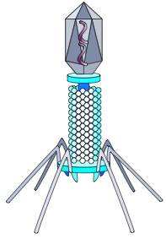

Cell Sizes
Most cells are between 1 and 100µm and visible only using a microscope.
Cell size is very diverse, a range of cells is shown below to illustrate this.
  A virus (a non-cellular particle) is included for comparison.
Eukaryotic cells
e.g. plant, animal, and fungal cells
Human white blood cells
Parenchyma cell of flowering plant
Size: 10-100 µm diameter. Cell organelles may be up to 10 µm.
.
Prokaryotic cells
Size: typically 2-10 µm
Length: 0.2-2 µm diameter
Upper limit: 30 µm long
Viruses
Size: 0.02-0.25 µm(20-250 nm)

Slide 6
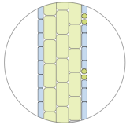
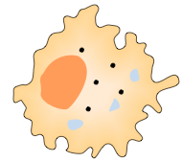

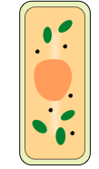




Relative Sizes
The following scale shows the size range of some representative cellular organelles, cells, and multicellular structures.
The scale is logarithmic to accommodate the range of sizes shown.
From left to right, each reference measurement marks a tenfold increase in diameter or length.
Leaf tissue
DNA
Plasma membrane
Animal cell
Plant cell
Golgi
Ribosome
Nucleus
Leaf

Slide 7
Units of Measurement
The International System of Units (SI units) is the modern form of the metric system. It is the most widely used system of units, both in commerce and science.
The table below illustrates some
common biological units of measure.
SI Units of Length
Unit | Meters | Equivalent
1 meter (m) | 1 m | 1000 millimeters
1 millimeter (mm) | 10⁻³ m | 1000 micrometers
1 micrometer (µm) | 10⁻⁶ m | 1000 nanometers
1 nanometer (nm) | 10⁻⁹ m | 1000 pedometers

Slide 8
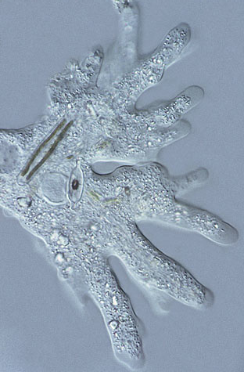
The Characteristics of Life
Life on Earth is very diverse, and takes on many shapes, forms, and functions. Despite this diversity, all living things share certain characteristics:
  Cellular organization: the basic unit of structure and function in living things
  Metabolism: chemical reactions and energy transfers
  Homeostasis: self-regulating control mechanisms.
  Growth and development: increase in size,
  number, and function of cells
  Sensitivity: response to environment
  Reproduction: the production of new cells or
  multicellular organisms
  Heredity: a genetic system based on the
  replication of DNA
A basic characteristic of life is a high degree of
organization.
Biological organization is hierarchical.
Photo credit: Dr Steve Durr
Life is cellular based

Slide 9

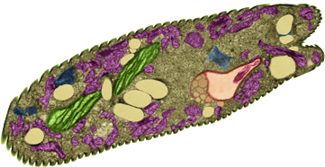
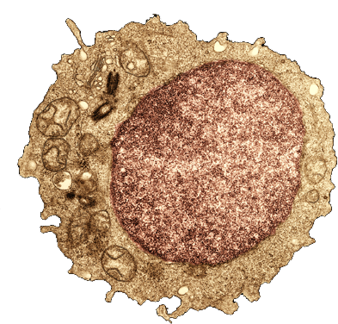
The Characteristics of Life
The cell is the site of life; it is the functioning unit structure from which living organisms are made.
Organisms can have varied morphologies (appearances), but there are often many similarities at the cellular level, i.e. in cell ultrastructure.
Photo: Brian Finerran
Unicellular eukaryote, Euglena
Plant cell
Human cell

Slide 10
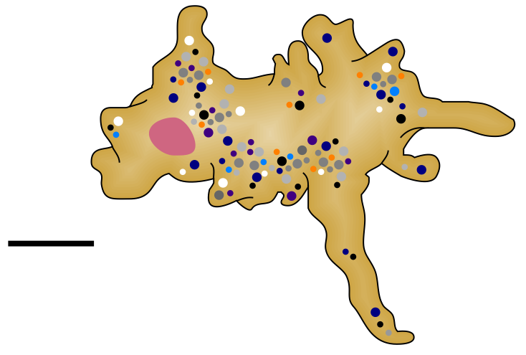
Cell Characteristics
Cells remain alive as long as the metabolic reactions in the cytoplasm are maintained.
With a few rare exceptions (which involve freezing certain types of cells) the cell dies if metabolism is stopped for any reason.
Plasma membrane
In eukaryotes, the DNA (as chromosomes) is contained within a nuclear membrane
100000 nm
scale
Specialized organelles carry out specific functions in the cell.
Metabolism takes place in the cytoplasm.
Amoeba:
a single celled eukaryote

Slide 11
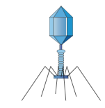

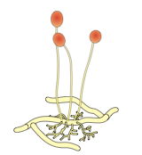
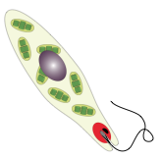

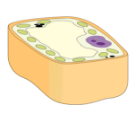
Types of Living Things
Non-cellular
Viruses
?
?
Prokaryotic cells
Relatively small cells
0.5-10 µm
Bacterial cells
Living things
Fungal cells
Cells
Protistan cells
Eukaryotic cells
Relatively large cells
30-150 µm
Animal cells
The division of living organisms into prokaryotes and eukaryotes is a fundamental classification division
Plant cells

Slide 12
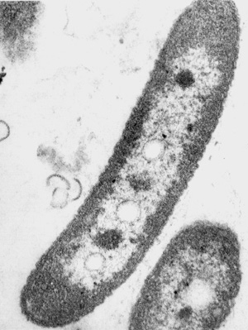
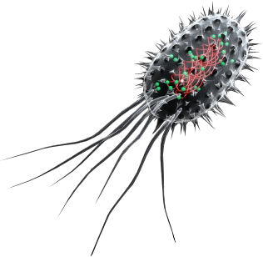
Introduction to Prokaryotes
Prokaryotic cells have no true nucleus.
Their genetic material is found a region called the nuclear area, but is not separated from the other cell material by a membrane.
Prokaryotic cells are generally smaller than eukaryotic cells.
Prokaryotes are usually
unicellular organisms.
Bacteria are prokaryotes.
E. coli: Lighter nuclear region

Slide 13
Eukaryotes
Eukaryotes are characterized by having their genetic material contained within a nuclear membrane.
Eukaryotic cells are generally much larger than prokaryotic cells.
They are more complex cellular organisms and have a variety of internal membranes and structures, called organelles.
Fungi, protistians, animals, and plants are all eukaryotic.
Human lymphocyte. Note the clearly defined nucleus

Slide 14
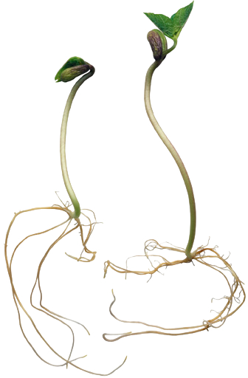
Eukaryotes
Eukaryote organisms can be:
  unicellular organisms (e.g. the protistians).
  multicellular organisms (e.g. plants).
Unicellular eukaryote, Euglena
Multicellular eukaryotes, bean seedlings

Slide 15
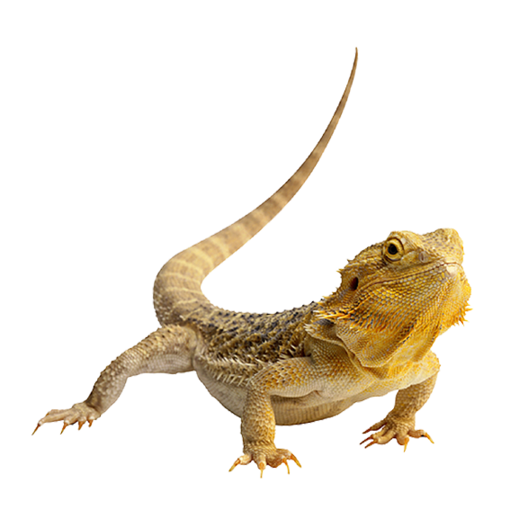
The Advantages of Being Multicellular
The evolution of multicellular organisms resulted in an increase of biological diversity.
Multicellular organisms are able to better adapt to a variety of environments and conditions because they can form specialist cells and tissues to perform specific tasks.
A bearded lizard
In multicellular organisms, specialized surface cells (in this case skin) collectively form a large organ that insulates the internal cells and tissues from environmental fluctuations.

Slide 16
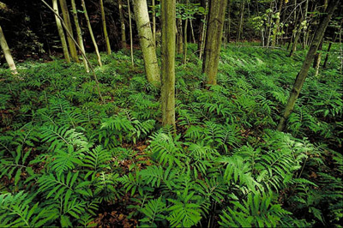

Energy Requirements in Living Things
All organisms require energy to grow, reproduce, move and carry out maintenance and repairs.
Organisms can be classified on their ability to procure energy:
  Autotrophs make their own energy using light or chemical energy.
  Heterotrophs obtain their energy from consuming other organisms or their dead remains.
Producers
Consumer

Slide 17
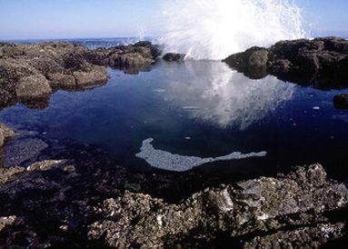

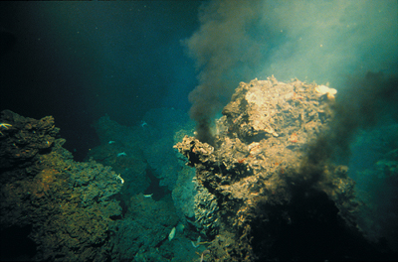
Cellular Environments
Cells must survive in a wide variety of environments.
While some environments are easy for cells to survive in, others are more hostile.
  In these more hostile environments, cells have developed special adaptive features to survive.
The environment that most closely resembles the inside of cells is sea water.
  It is likely that life almost certainly evolved in the oceans.
Saline rock pools (above) and deep sea hydrothermal vents (below) were likely environments for early cells

Slide 18
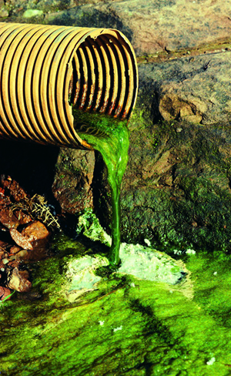
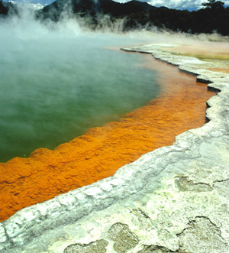
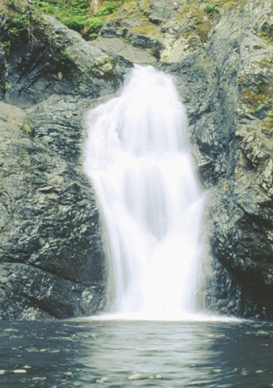
Cellular Environments
Life has adapted to every conceivable type of environment on Earth, including:
Polluted environments: human actions, e.g. pollutants from industry or agriculture alter the environment.
R.F Alamy
Geothermal areas: cells adapt to extremely high temperatures.
Freshwater:
cells adapt to the lack of dissolved salts.

Slide 19
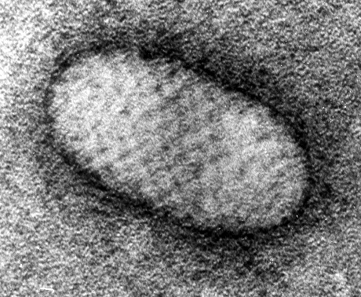
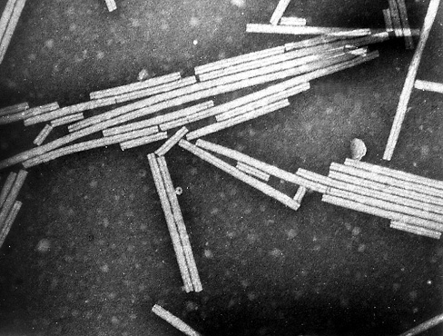
Introduction to Viruses
Viruses:
  are non-cellular. They are not generally classed as living organisms.
  have a typical size range of 20-300 nm.
  contain no cytoplasm or organelles.
  have no chromosome, just RNA or DNA strands.
  are covered in a protein coat.
  are parasitic, and depend on a host cell for both their metabolism and their reproduction.
Orf virus
Tobacco mosaic virus

Slide 20
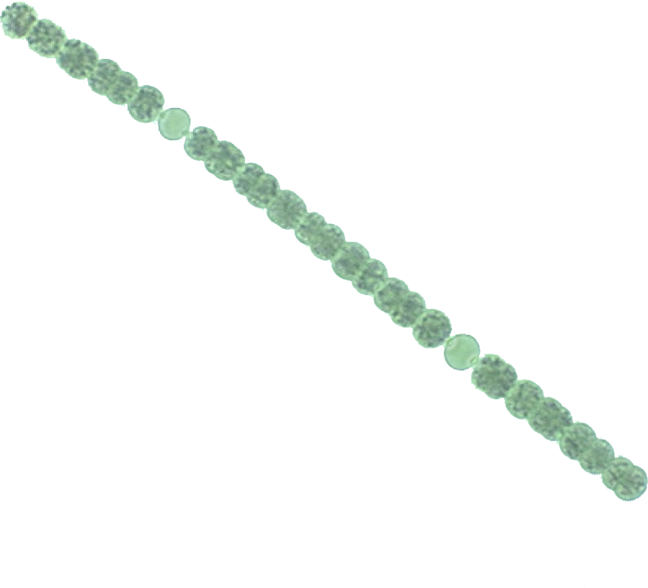
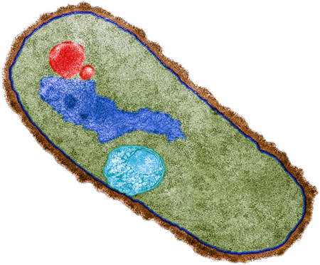
Introduction to Bacteria
Bacterial cells:
  are single-celled organisms.
  have no membrane-bound nucleus or organelles.
  have DNA, usually as a single chromosome.
  have cell walls of peptidoglycan. Many secrete a capsule.
Bacillus megaterium, clearly showing the plasma membrane (blue). The thick cell wall (brown) surrounds the entire cell, but there are no membrane-bound cellular organelles.
Cyanobacterial cells (Anabaena). Cyanobacteria are also called the blue-green bacteria.

Slide 21
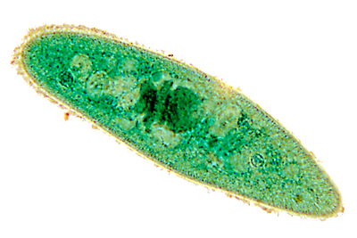
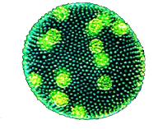
Introduction to Protist Cells
Protistan cells:
  are mainly single-celled or exist as cell colonies.
  have a nucleus and membrane-bound organelles.
  can be autotrophic (contain chlorophyll and carry out photosynthesis) or can be heterotrophic.
Paramecium (top) and Euglena (center) are examples of unicellular protists.
Volvox (lower) is a colonial protist.

Slide 22
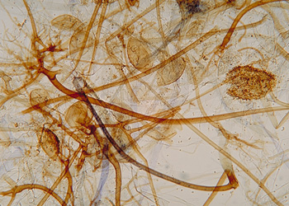
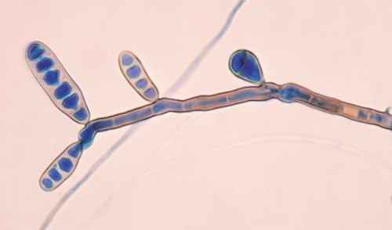
Introduction to Fungi
Fungal cells:
  are rarely found as discrete cells.
  have a nucleus and membrane-bound organelles.
  are plant-like in appearance, but lack chlorophyll.
  have rigid cells walls that contain chitin.
  are heterotrophic.
CDC
Tangled mass of fungal cells
Fungal cells with cone-like reproductive structures

Slide 23
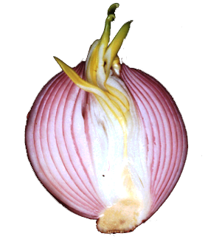
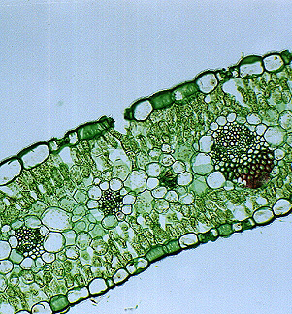
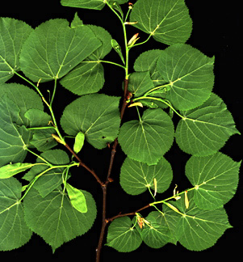
Introduction to Plant Cells
Plant cells:
  exist as part of multicellular organisms (plants) with specialized cells of many different types.
  have a nucleus and membrane-bound organelles.
  are typically autotrophic, photosynthetic cells with chloroplasts.
  have a cellulose cell wall.
Bulb
Many of the cells making up the plant body are photosynthetic
Leaf section

Slide 24



Introduction to Animal Cells
Animal cells:
  exist as part of multicellular organisms (animals) with specialized cells of many different types.
  possess a nucleus and membrane-bound organelles.
  lack cell walls.
  are heterotrophic.
Arachnid
CDC
Mollusk
Even the simplest animals are complex multicellular organisms composed of many different types of specialized cells.
Rotifer

Slide 25

Plant Cells
Plant cells consist of a protoplast enclosed in a cellulose cell wall.
A protoplast is the name for all the cell contents within the plasma membrane, but does not include the cell wall.
Cell membrane
Cell wall
The plant cell (right) clearly shows the cell wall colored green, and brown line of the cell membrane laying inside of the cell wall.
Photo: Brian Finerran

Slide 26

Animal Cells
Animal cells (right), unlike plant cells, have irregular shapes.
Some animal cells (such as phagocytes) are able to alter their shape for various purposes (e.g. engulfment of foreign material).
Some animal cells have flagellum which enables the cell to move (e.g. spermatozoan).

Slide 27


Cell Specialization
“Typical cells” are often used to demonstrate cellular characteristics, but in reality there is no typical cell.
Cells vary in their shape and contents to match their environment and biological function.
The cells of unicellular organisms, such as
the amoeba (right), remain quite unspecialized
and must carry out a range of biological functions.
The cells of multicellular organisms exhibit
much greater specialization;
each cell type may perform only a
limited number of tasks,
e.g. a red blood cell carries
oxygen but has no nucleus.
Epidermal cells
Heart cells
Liver cells
Bone cells

Slide 28


Plant Cell Specialization
Plants show a wide variety of cell types, each with structural adaptations to allow them to perform a specific function.
During cell specialization the cell components and cell wall have become adapted for a specialist role.
Relatively unspecialized parenchyma cell
Pollen houses the male gametophyte generation in seed plants
Guard cells forming a stoma, which regulates water losses from the leaf
Photo: Brian Finerran

Slide 29



Plant Cell Specialization
The vegetative plant body consists of three organs:
  stems
  leaves
  roots
Flowers, fruits, and seeds are additional organs
that are concerned with plant reproduction.
Leaves
Seeds
Stem
Roots
Flowers
The three organs of a plant are labeled on this coriander plant.
Fruit
Fruits, seeds and flowers (arrowed left) are reproductive structures.

Slide 30




Plant Cell Specialization
Palisade parenchyma cell
    Features:
    Columnar shaped packing cells
    containing chloroplasts.
    Functions:
    Primary site of photosynthesis
Guard cells
    Features:
    Unevenly thickened cell walls provide
    rigidity and enable stoma to open
    Functions:
    Open or close stomata to regulate water loss
RCN
Chloroplast
Pore
Uneven thickening of the cell wall makes this side more rigid

Slide 31


Plant Cell Specialization
Sieve element of phloem
    Features:
    Long, tube-shaped cells with their ends perforated by pores (the sieve plate). Cells lack a nucleus but alive, supported by adjacent companion cells.
    Functions:
    Transport of dissolved sugars
Vessel element of xylem
    Features:
    Rigid remains of a dead cell.
    No cytoplasm. End walls perforated.
    Walls are strengthened with lignin.
    Functions:
    Rapid conduction of water.
    Provides support for the plant.
Sieve element
Nucleated companion cell
Sieve plate
Lignin
Perforated end wall

Slide 32


Plant Cell Specialization
Cell wall
Stone cells (sclereids)
    Features:
    Heavily lignified cells with only
    a small region of cytoplasm.
    Functions:
    Protection against mechanical stress,
    e.g. protecting the seed inside the fruit.
Pollen grain
    Features:
    Lightweight structure containing a large tube cell and a small generative cell which produces the two sperm. The cells are surrounded by a cellulose cell wall and a tough outer wall made of sporopollenin.
    Functions:
    Houses the male gametophyte generation in seed plants.
Cytoplasm
Lignified cell wall
Sporopollenin wall
Sperm cell
Tube nucleus
Pollen tube

Slide 33



Plant Cell Specialization
Waxy cuticle
Epidermal cells
    Features:
    Relatively generalized cells with waxy layer on the upper surface.
    Functions:
    Reduces water loss from the leaf surface.
Root hair cell
    Features:
    Very thin cuticle with no waxy layer. High surface area to volume ratio.
    Functions:
    Facilitates the uptake of water and ions from the soil.
Nucleus
Vacuole
Root tip showing the halo of thin walled root hairs
Thin, cellulose cell wall (fully permeable)

Slide 34









Differentiation of Human Cells
The human body exhibits a high level of cellular specialization.
  All of the 230 types of cells present in a human body are derived from a single fertilized egg cell (or zygote) by differentiation.
  A zygote is totipotent; it has the capacity to differentiate into a fully formed embryo.
Intestinal cell
Muscle fiber
Bone cell
Retinal rod
Red blood cell
Nerve cell
White blood cell
Retinal cone

Slide 35







Differentiation of Human Cells
Regulation of gene expression determines
what cell type will develop from a totipotent embryonic cell (a stem cell).
Gene expression is regulated so that some genes are switched on (activated), and others are switched off (deactivated) during the course of development.
Blood vessels
Spinal tissue
Glands
Kidney
Bone
Mesoderm
Ectoderm
Endoderm
Germline
Lung
Gastrula:
two layered embryo
Sperm producing cells
Zygote:
fertilized egg

Slide 36



Differentiation Potential
A zygote has unlimited ability to differentiate; it can develop into any cell type.
As the organism develops, the differentiation potential of a cell lessens,
so that fewer differentiation options are available.
Eventually, a cell’s fate is determined, and it takes on a specific form and function.
Germ line
Endoderm
Mesoderm
Ectoderm
Zygote:
fertilized egg
Morula:
solid ball of cells
Gastrula:
two layered embryo
Brain and spinal cord
Somites (muscle)
In this a 24 hour chick embryo the differentiation of the brain, spinal cord, and muscle has already begun.
Spinal tissue

Slide 37





Differentiation of Human Cells
Cell specialization begins four days after fertilization at the blastocyst stage.
Gastrulation is the next phase of embryonic development. Its purpose is to position the three distinct germ layers: the endoderm, mesoderm, and ectoderm.
Gastrulation is achieved by migration of the embryonic cells within the embryo. The three germ layers (or cell lines) are the forerunners for all adult cells and tissues.
Because three germ layers form, all vertebrate embryos are said to be triploblastic.
Zygote
Fertilized egg cell
Blastula
Hollow ball of cells
Eight cell stage
Gastrulation
Gastrula
Cleavage
Cleavage
Endoderm
Ectoderm

Slide 38


Endoderm
The endoderm is the innermost germ layer.
In the early embryo the endoderm forms the
embryonic gut.
It differentiates to form:
  the digestive system
  glands
  part of the respiratory system
Lung
Thyroid
Pancreas

Slide 39


Mesoderm
The mesoderm is the middle germ layer, between the ectoderm and endoderm.
The mesoderm differentiates to give rise to:
  muscles
  circulatory system (heart and blood vessels)
  excretory system
  dermis (inner skin layer)
  skeleton, and other supportive and connective tissue.
Bone
Skeletal muscle
Kidney tissue
Red blood cells and blood vessels
Smooth muscle (gut)

Slide 40


Ectoderm
The ectoderm is the outermost germ layer.
In the fully developed embryo and adult human the ectoderm forms:
  brain and the nervous system
  epidermis of skin (including hair, sweat glands and nails)
  tooth enamel
  some endocrine glands
  cornea and lens of the eye
Neurons
Epidermis (skin)
Sebaceous glands
Retinal and pigment cells

Slide 41
Human Cell Specialization
Red blood cell (erythrocyte)
    Features:
    Biconcave cell. Lacks nucleus and mitochondria. Contains hemoglobin.
    Functions:
    Uptake, transport, and release of oxygen to the tissues.
Phagocytic white blood cell (neutrophil)
    Features:
    Highly mobile cell capable of engulfing bacteria and other foreign material by phagocytosis.
    Functions:
    Destroys pathogens, foreign material and cell debris.
No nucleus
Hemoglobin gives red color
Phagocytic
Highly mobile

Slide 42


Human Cell Specialization
Motor neuron
    Features:
    Cell has long extensions (axons) with
    synaptic bodies. Insulated with fatty
    material (myelin) for improved conduction.
    Functions:
    Rapid conduction of nerve impulses from spinal cord to effectors.
Retinal rod
    Features:
    Long, narrow cell. Contains light sensitive pigment (rhodopsin).
    Functions:
    Vision. Detection of light results in a structural change and generation of a nerve impulse.
Insulated axon
Synaptic bodies
Nucleus
Membrane disks containing pigment

Slide 43


Human Cell Specialization
Microvilli
Intestinal epithelial cell
    Features:
    Columnar cell with a high surface area to volume ratio as a result of finger-like projections on the surface (microvilli).
    Functions:
    Rapid absorption of nutrients into the bloodstream.
Skeletal muscle cells (fibers)
    Features:
    Large, multinucleate cylindrical cells composed of banded myofibrils. Capable of contraction (shortening).
    Functions:
    Responsible for movement via the action of voluntary muscles on the skeleton.
Epithelial cells line the villi of the intestine
Nucleus
Plasma membrane of muscle cell
Muscle fibers in cross section
Filaments

Slide 44


Human Cell Specialization
Spermatocyte
    Features:
    Motile, flagellated cell with many mitochondria. The nucleus forms a large proportion of the cell.
    Functions:
    Male gamete for sexual reproduction.
Osteoblasts
    Features:
    Cell surrounded by a calcium matrix. Fingerlike extensions supply nutrients, and remove wastes from the cell.
    Functions:
    In early stages, secretes the matrix that will become bone. Provides strength.
Nucleus
Maturing spermatozoa
Fingerlike extensions of cytoplasm
Bone tissue: the osteoblasts stain dark blue

Slide 45



Levels of Organization
Organization is a defining feature of living things.
Organisms are organized according to a hierarchy of structural levels.
  Chemical and molecular level:
  Atoms and molecules form the most basic level of organization. This level includes all the chemicals essential for maintaining life.
  Organelle level
  Molecules associate together to form complex,
  highly specialized structures and organelles
  within cells. e.g. mitochondria, chloroplasts.
  Cellular level
  Cells are the basic structural and functional
  units of organisms. Cells become specialized
  to perform specific functions as a result of differentiation during development.
Golgi apparatus
Kidney tubule cells

Slide 46


Levels of Organization
  Tissue level:
  Tissues are composed of groups of cells of similar structure that perform particular related functions.
  Organ level
  Organs are structures of definite form and structure, comprising two or more tissues.
  Organ system level
  In animals, organs form parts of larger units known as organ systems. An organ system is an association of organs with a common function, e.g. digestion or excretion.
Kidney tissue: glomeruli, tubule cells, Bowman’s capsule
Kidneys are organs of excretion and are part of the excretory system.

Slide 47





Animal Tissues
Biological tissue is a group of cells in an organism that perform a similar or related function.
Tissues improve the efficiency of operation because they enable tasks to be shared amongst various specialized cells.
The study of tissues is called histology.
Animal tissues can be divided into four broad groups:
  epithelial tissue, e.g columnar epithelium of gall bladder
  connective tissue, e.g. bone
  muscle tissue, e.g. cardiac muscle
  nervous tissue, e.g. neurons, spinal cord
A
B
A
C
B
C
D
D

Slide 48

Connective Tissue
Connective tissue is the major supporting tissue of the animal body.
The cells are widely dispersed in a matrix, which ranges from being dense, as in bone, to fluid, as in blood.
Connective tissues bind other structures together and provide support, and protection against damage, infection, or heat loss.
Connective tissues include:
  dentine (teeth)
  adipose (fat) tissue
  bone and cartilage
  tissues around the body’s
  organs and blood vessels.
  blood (a liquid tissue)
In this embryo of a mouse, bone (magenta) and cartilage (blue) are highlighted by selective staining

Slide 49



Nervous Tissue
Nervous tissue consists of two principal cell types:
  Neurons: the structural and functional cells of the nervous system. Neurons are specialized to transmit and receive nerve impulses.
  Neuroglia: the supporting cells of the nervous system. They are highly branched, supportive cells, which do not conduct nerve impulses.
Supporting cells and connective tissue containing blood vessels may be associated with the neurons.
Photos right:
  Axon branches supplying muscle fibers
  Layer of giant Purkinje neurons of the cerebellum
  Motor neurons (arrowed) from the spinal cord. Supporting glial cells lie in between.
A
B
A
B
C
C

Slide 50



Muscle Tissue
Muscle tissue consists of very highly specialized cells called fibers, held together by connective tissue.
  The main feature of muscle tissue is that it is contractile and therefore responsible for both voluntary and involuntary (unconscious) body movements.
  Contraction is accomplished by the interaction of contractile proteins.
There are three types of muscle in the body:
  cardiac muscle: cylindrical, branching cells connected by intercalated discs.
  skeletal muscle: large, long, cells with mulitple peripheral nuclei.
  smooth muscle: no striations, spindle-shaped cells with single central nucleus
Type: Cardiac muscle
Location: Heart
Type: Skeletal (striated) muscle
Location: Attached to bone.
Type: smooth muscle. Location: walls of hollow organs, skin, glands

Slide 51


Epithelial Tissue
Epithelial tissue is organized into single or layered sheets of cells.
Classification of epithelial tissue is based on the number of cell layers and the morphology of the surface cells.
Epithelial tissue lines internal and external surfaces (e.g. blood vessels, ducts, gut lining) and protects the underlying structures from wear, infection, or pressure.
Epithelial cells rest on a basement membrane and are held together by a glue-like intercellular substance.
Epithelial cells may also be ciliated or variously specialized for absorption, secretion, or excretion.
Simple columnar epithelium, gall bladder
Stratified epithelium, vagina. Note the many layers and how the cells flatten near the surface.

Slide 52


Plant Tissues
Cortex
Plant tissues are divided into two groups:
  Simple tissues contain only one cell type and form packing and support tissues (e.g. parenchyma).
  Complex tissues contain more than
  one cell type and form the conducting and support tissues of plants
  (e.g. periderm, xylem, phloem).
Pith
Simple parenchyma tissue forms the central pith and outer cortex of this monocot root.
Phloem
In this vascular bundle of a young stem, both xylem and phloem can be seen. These two complex plant tissues are grouped together in vascular bundles as the water and nutrient transporting tissues of the plant.
Xylem
Xylem vessel
Photo credit: Warwick Silvester
Air space

Slide 53



Simple Plant Tissue
Parenchyma tissue is an example of a simple plant tissue type.
Parenchyma tissues are relatively unspecialized, and have a thin primary cell wall. Types include:
  Chlorenchyma: contains chloroplasts for photosynthesis.
  Aerenchyma: contains large intracellular air spaces and functions in gas exchange.
  Endodermis: regulates transport
  of materials into the vascular
  bundles of most roots and some leaves and stems.
  Storage parenchyma: accumulate storage products such as starch, protein, or water.
Chloroenchyma
Aerenchyma
Endodermis

Slide 54


Complex Plant Tissue
Xylem is a good example of a complex plant tissue.
It is the principal water conducting tissue in vascular pants and has a role in support.
Xylem comprises five cell types:
  tracheids (strength, conduction)
  vessels (strength, conduction)
  xylem parenchyma (storage)
  sclereids (support)
  fibers (support)
Photo credit: Warwick Silvester
Xylem showing vessels (pink) and storage parenchyma (blue)
Xylem fibers in cross section. Note the thickened walls.

Slide 55


Slide 56
Terms of Use
Biozone International retains copyright to the intellectual property included in this presentation file, with acknowledgement that certain photos are used under license and are credited appropriately on the next screen.
You MAY:
  Use these slides for presentations in your classrooms using a data projector, interactive whiteboard, and overhead projector.
  Place these files on the school’s intranet (school computer network), but not in contradiction of clause 3 (a) below.
  Edit and customize this file by adding, deleting, and modifying information to better suit your needs.
  Place these presentation files on any computer within the school, including staff laptops.
  Print out this file in PowerPoint “Handouts” format as per the print dialogue box, for the express purpose of allowing students to make their own notes about the presentation.
You MAY NOT:
  Put these presentation files onto the internet or on a service that may be accessed offsite from the campus, unless access to the service is protected by a user login and password protocol.
  Print these files onto paper to make your own worksheets for distribution to students.
  Create a NEW document using any of the graphics/images in this presentation file.
  Incorporate any part of this presentation file for the production of another commercial product.
  REMOVE any of the references to Biozone, the copyright notices, photo credits, or terms of use from this file.

Slide 57
Photo Credits
Images Used Under Licence
Photographic images are used under licence from the following photo libraries:
  Corel Corporation Professional Photos
  (various titles, including: Science & Medicine, Agriculture).
  ArtToday.com
  Clipart.com
  PhotoDisc Inc.
  Hemera Technologies Inc.
  PhotoObjects.com
  Visuals Unlimited
  iStock
  Education Interactive Imaging
  Digital Vision Photographic Library
Images Used with Permission
Photographic images used with permission from the copyright holder:
Steve Durr; University College of London
Warwick Silvester: University of Waikato
Brian Finerran: University of Canterbury
R.F Alamy
Waikato Microscope Unit (WMU)
Ralph Cocklin
Images from the Public Domain
Images from the public domain include copyright expired, uncopyrighted, or uncopyrightable material:
CDC Public Health Image Library (PHIL)
Additional artwork and photographs are the property of Biozone International Ltd.
BIOZONE International Ltd | P.O. Box 13-034, 109 Cambridge Road, Hamilton, NEW ZEALAND
Phone: + 64 7 856-8104 | Fax: + 64 7 856-9243 | E-mail: sales@biozone.co.nz | Internet: www.biozone.co.nz
Copyright © 2007 Biozone International Ltd
All rights reserved

Slide 58






Presentation MEDIA
Our current range includes:
See full details on our web site:
www.thebiozone.com/media.html

